Slide 1
A TIME SERIES IS WORTH 64 WORDS: LONG-TERM FORECASTING WITH TRANSFORMERS
Published at ICLR 2023, cited by 1515

Slide 2
Overview
PatchTST: A novel Transformer-based Model for Time Series Forecasting
leveraging patching and channel independence
Patching Strategy:
Segments time series into subseries-level patches (input tokens for Transformer)
Retains local semantic information
Reduces computation & memory (quadratic savings in attention maps)
Enables longer historical dependencies
Channel Independence:
Each channel processes a single univariate time series
Shares embedding and Transformer weights across all series
Performance:
Outperforms SOTA Transformer models in long-term forecasting accuracy

Slide 3
Limitation and Address the limitation
Limitation:
Regardless of the complicated design of Transformer-based models, it is shown in recent papers that a very simple linear model can outperform all of the previous models on a variety of common benchmarks, and it challenges the usefulness of Transformer for time series forecasting.
To address this challenge, they proposed a channel-independence patch time series Transformer (PatchTST) model that contains the following key designs:
Patching
Channel Independent
Using self-supervised learning to enhance the accuracy

Slide 4
Patching and Channel-Independence
Patching in Time Series Forecasting
Time series forecasting analyzes correlations across time steps
Unlike words in a sentence, a single time step lacks semantic meaning
Extracting local semantic information is crucial for understanding connections
Patching helps capture meaningful patterns within time series data
Channel-Independence in Multivariate Time Series
A multivariate time series is a multi-channel signal
Two input token designs for Transformer models:
Channel-mixing: Combines all time series features into a single token
Channel-independence: Each token represents a single channel only
Channel-independence has been successful in CNNs and linear models
In this work, this channel-independence method is effective in Transformer-based models

Slide 5
The key novelty of this work
Reduction of time and space complexity:
Patching reduces N by a factor of the stride: N ≈ L / S
N = Number of input tokens, L= input sequence
Capability of learning from the longer look-back window:
Longer sequences due to memory and computation costs
Time series data contains temporal redundancy
Models can still retain sufficient information for accurate forecasting
Capability of representation learning:
Using representation learning can further enhance forecasting performance.

Slide 6
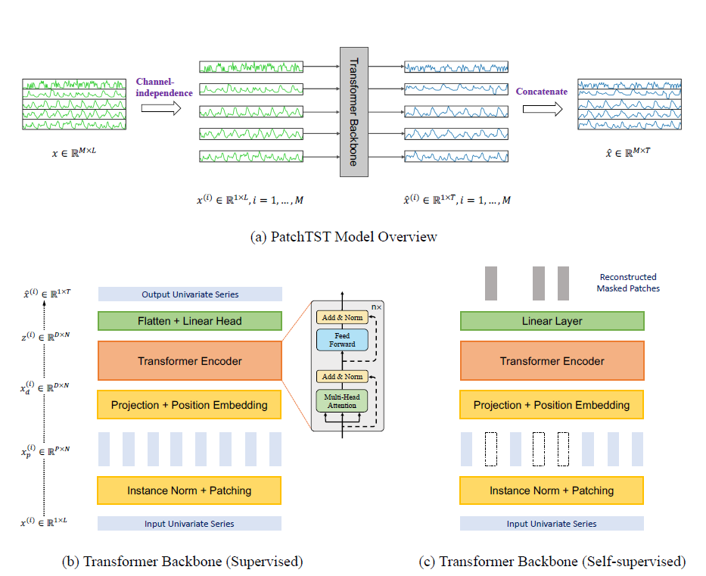
Overview of architecture

Slide 7
Proposed Method
Forward path (instance Normalization & Patching):
Channel-Independence: Each time series channel is processed independently through the Transformer backbone, sharing weights across all series.
Each univariate time series is normalized and divided into patches (subseries) instead of using individual time steps.
Transformer Backbone:
Patches are mapped to an embedding space and processed through a vanilla Transformer encoder. Multi-head self-attention mechanism captures dependencies within each series.
Prediction Mechanism:
The encoded features are flattened and passed through a linear head to produce future time steps. Uses Mean Squared Error (MSE) loss for training.

Slide 8
Proposed Method
Representation Learning:
Leverage self-supervised learning to extract meaningful representations from time series data that can be transferred to forecasting tasks.
Masked Autoencoder Approach: Uses masked patch prediction, where a subset of time series patches is randomly masked and the model learns to reconstruct them
Unlike existing methods that mask individual time steps, this approach forces the model to understand broader temporal dependencies.
Patch-based Representation Learning: Patches are non-overlapping to ensure masked patches don’t contain information from adjacent observed patches.
The model is trained using MSE loss to reconstruct missing patches.
The advantage of using representation learning:
Captures high-level patterns: rather than simple interpolation between adjacent time points.
Transferability: The pre-trained model can be fine-tuned for different forecasting tasks, outperforming fully supervised training.

Slide 9
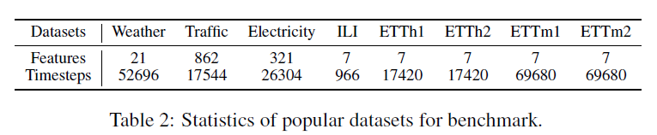
Results
It evaluates the performance of our proposed PatchTST on 8 popular datasets, including Weather, Traffic, Electricity, ILI and 4 ETT datasets (ETTh1, ETTh2, ETTm1, ETTm2).
PatchTST/64 implies the number of input patches is 64, which uses the look-back window L = 512.
PatchTST/42 means the number of input patches is 42, which has the default look-back window L = 336.
Both of them use patch length P = 16 and stride S = 8.

Slide 10
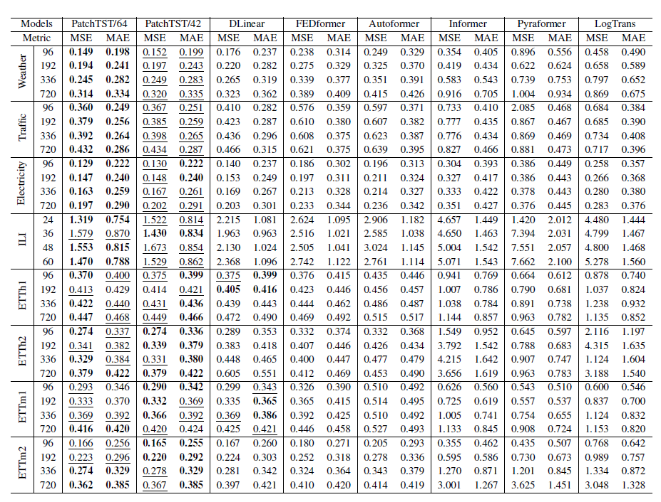
Results

Slide 11
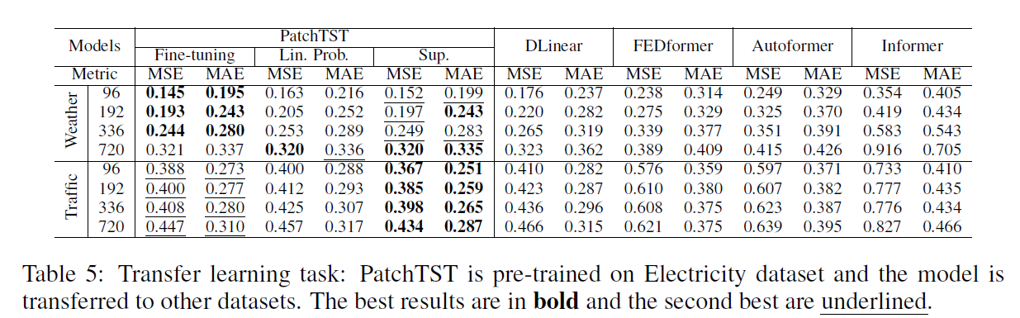
Transfer Learning Experiment
Evaluates the ability of the pre-trained model to adapt to new datasets.
Pre-training: The model is first trained on the Electricity dataset and then fine-tuned on other datasets.
Fine-tuning Performance: Slightly worse than fine-tuning on the same dataset.
Fine-tuning outperforms other baseline models in forecasting accuracy.

Slide 12
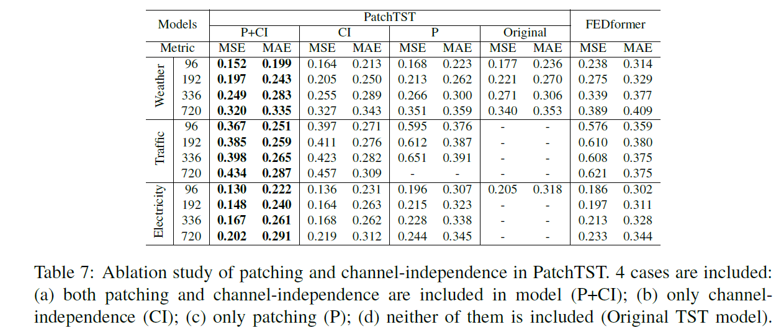
Ablation Study: Evaluating Model Components
Patching and Channel-Independence:

Slide 13
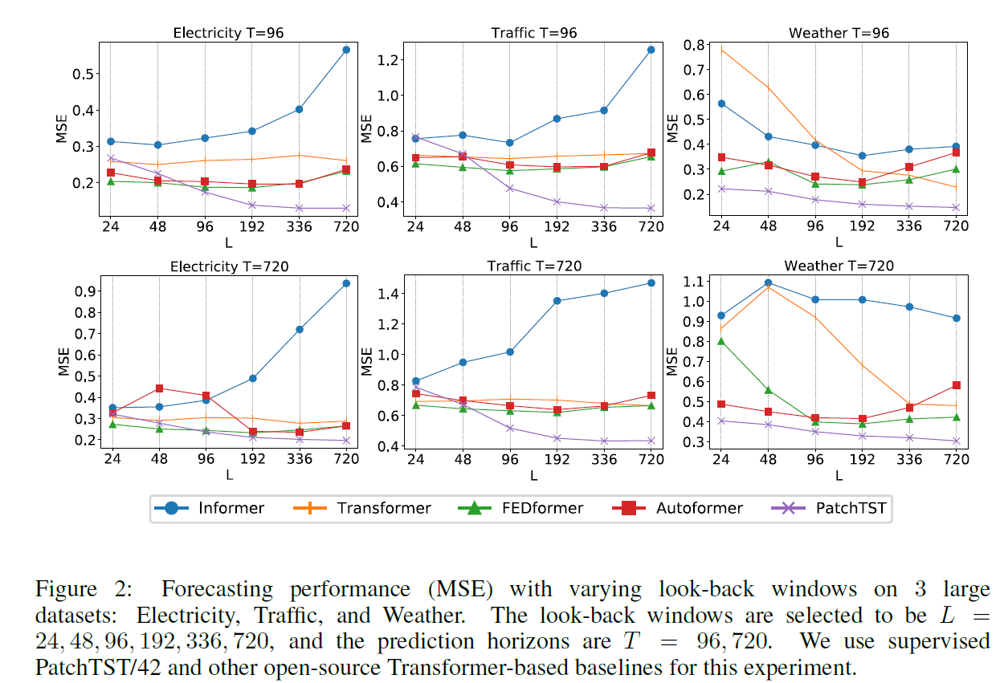
Ablation Study: Evaluating Model Components
Effect of Look-Back Window:
Advantages: Learns more adaptable attention patterns for different time series. Requires less training data to converge. Reduces overfitting, making it more stable during training.

